Slide 1

Parking Spot Reservation System
Kydyraliev Aidin

Slide 2

Introduction
Introduction
This project aims to develop a Parking Spot Reservation System to efficiently manage parking spaces. With increasing urbanization, effective parking management becomes crucial for minimizing congestion and maximizing space utilization.

Slide 3

Code Structure
Code structure
Header includes
Functions:
The code includes necessary header files such as <iostream> and <vector> for input-output operations and vector usage, respectively.
clear(): Clears the console.
display(): Displays the parking lot map, indicating reserved spots, empty spots, and roads.
parkCar(): Reserves a parking space if available.
unparkCar(): Cancels a parking reservation.
initializeParkingLot(): Initializes the parking lot layout.
placeCars(): Randomly places cars in the parking lot.
letterToRow(): Converts a letter to a row index.
Global Constants
Constants like ROWS and COLS define the dimensions of the parking lot.
Data Structures
The parking lot is represented as a 2D vector.

Slide 4
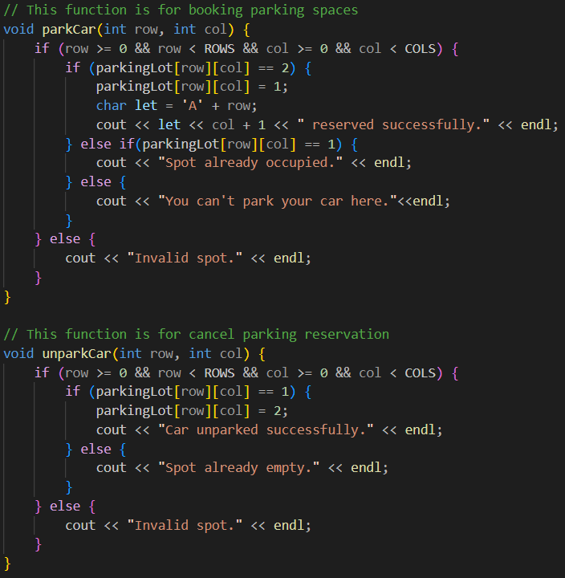
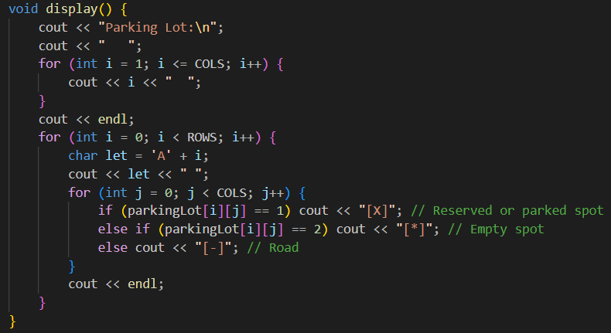
MAIN FUNCTIONS
display()
parkCar()
unparkCar()

Slide 5

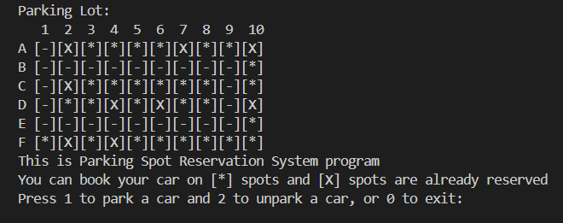
Features
Dynamic Display
Reservation and Cancellation
Random Car Placement
Users can see the current status of the parking lot.
Simulates random cars already parked in the lot.
Users can reserve and cancel parking spaces as needed.

Slide 6

Usage
To use the program:
Run the program.
Follow on-screen instructions.
Choose option 1 to reserve a parking spot or option 2 to cancel a reservation.
Enter the row (A-F) and column (1-10) as prompted.
Exit the program by choosing option 0.
Usage

Slide 7
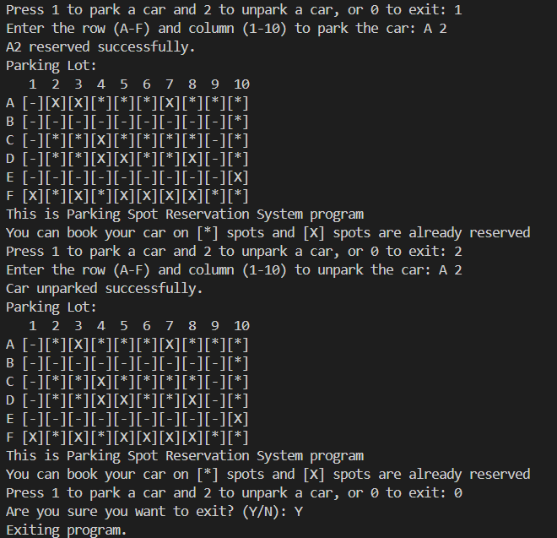

OVERVIEW

Slide 8

SUMMARY AND DIFFICULTIES
Summary:
The Parking Spot Reservation System provides a user-friendly interface for managing parking spaces efficiently. It can be further enhanced with features like user authentication and real-time updates.
Difficulties:
Designing system structure for efficient parking space management.
Implementing robust input validation and error handling.
Documenting code for future maintenance and collaboration..

